Slide 1
Searching: Binary Trees
Chapter 12
Nyhoff, ADTs, Data Structures and Problem Solving with C++, Second Edition, © 2005 Pearson Education, Inc. All rights reserved. 0-13-140909-3
1

Slide 2
Chapter Contents
12.1 Review of Linear Search and Binary Search
12.2 Introduction to Binary Trees
12.3 Binary Trees as Recursive Data Structures
Nyhoff, ADTs, Data Structures and Problem Solving with C++, Second Edition, © 2005 Pearson Education, Inc. All rights reserved. 0-13-140909-3

Slide 3
Linear Search
Collection of data items to be searched is organized in a list
x₁, x₂, … x_{n}
  Assume = = and < operators defined for the type
Linear search begins with item 1
  continue through the list until target found
  or reach end of list
Nyhoff, ADTs, Data Structures and Problem Solving with C++, Second Edition, © 2005 Pearson Education, Inc. All rights reserved. 0-13-140909-3

Slide 4
Linear Search
Vector based search function
template <typename t>
void LinearSearch (const vector<t> &v,
const t &item,
boolean &found, int &loc)
{ found = false; loc = 0;
for ( ; ; )
{ if (found || loc == v.size()) return;
if (item == x[loc]) found = true;
else loc++; }
}
Nyhoff, ADTs, Data Structures and Problem Solving with C++, Second Edition, © 2005 Pearson Education, Inc. All rights reserved. 0-13-140909-3

Slide 5
Linear Search
Singly-linked list based search function
template <typename t>
void LinearSearch (NodePointer first,
const t &item,
boolean &found, int &loc)
{ found = false; locptr = first;
for ( ; ; )
{ if (found || locptr == null) return;
if (item == locptr->data)
found = true;
else
loc++; }
}
In both cases, the worst case computing time is still O(n)
Nyhoff, ADTs, Data Structures and Problem Solving with C++, Second Edition, © 2005 Pearson Education, Inc. All rights reserved. 0-13-140909-3

Slide 6
Binary Search
Binary search function for vector
template <typename t>
void LinearSearch (const vector<t> &v,
const t &item,
boolean &found, int &loc)
{ found = false;
int first = 0; last – v.size() - 1;
for ( ; ; )
{ if (found || first > last) return;
loc = (first + last) / 2;
if (item < v[loc])
last = loc + 1;
else if (item > v[loc])
first = loc + 1;
else /* item == v[loc] */ found = true;
}
}
Nyhoff, ADTs, Data Structures and Problem Solving with C++, Second Edition, © 2005 Pearson Education, Inc. All rights reserved. 0-13-140909-3

Slide 7
Binary Search
Usually outperforms a linear search
Disadvantage:
  Requires a sequential storage
  Not appropriate for linked lists
It is possible to use a linked structure which can be searched in a binary-like manner
Nyhoff, ADTs, Data Structures and Problem Solving with C++, Second Edition, © 2005 Pearson Education, Inc. All rights reserved. 0-13-140909-3

Slide 8
Binary Search Tree
Consider the following ordered list of integers
Examine middle element
Examine left, right sublist (maintain pointers)
(Recursively) examine left, right sublists
13
28
35
49
62
66
80
Nyhoff, ADTs, Data Structures and Problem Solving with C++, Second Edition, © 2005 Pearson Education, Inc. All rights reserved. 0-13-140909-3

Slide 9
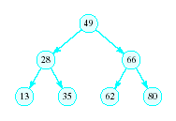
Binary Search Tree
Redraw the previous structure so that it has a treelike shape – a binary tree
Nyhoff, ADTs, Data Structures and Problem Solving with C++, Second Edition, © 2005 Pearson Education, Inc. All rights reserved. 0-13-140909-3

Slide 10
Trees
A data structure which consists of
  a finite set of elements called nodes or vertices
  a finite set of directed arcs which connect the nodes
If the tree is nonempty
  one of the nodes (the root) has no incoming arc
  every other node can be reached by following a unique sequence of consecutive arcs
Nyhoff, ADTs, Data Structures and Problem Solving with C++, Second Edition, © 2005 Pearson Education, Inc. All rights reserved. 0-13-140909-3

Slide 11
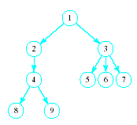
Trees
Tree terminology
Root node
Children of the parent (3)
Siblings to each other
Leaf nodes
Nyhoff, ADTs, Data Structures and Problem Solving with C++, Second Edition, © 2005 Pearson Education, Inc. All rights reserved. 0-13-140909-3

Slide 12
Binary Trees
Each node has at most two children
Useful in modeling processes where
  a comparison or experiment has exactly two possible outcomes
  the test is performed repeatedly
Example
  multiple coin tosses
Nyhoff, ADTs, Data Structures and Problem Solving with C++, Second Edition, © 2005 Pearson Education, Inc. All rights reserved. 0-13-140909-3

Slide 13
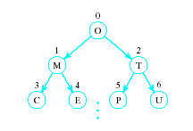

Array Representation of Binary Trees
Store the i^{th} node in the i^{th} location of the array
Nyhoff, ADTs, Data Structures and Problem Solving with C++, Second Edition, © 2005 Pearson Education, Inc. All rights reserved. 0-13-140909-3

Slide 14
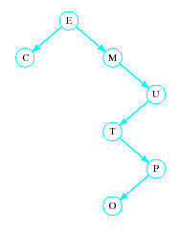
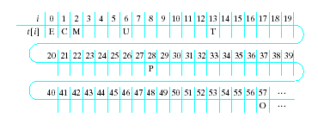
Array Representation of Binary Trees
Works OK for complete trees, not for sparse trees
Nyhoff, ADTs, Data Structures and Problem Solving with C++, Second Edition, © 2005 Pearson Education, Inc. All rights reserved. 0-13-140909-3

Slide 15
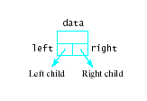

Linked Representation of Binary Trees
Uses space more efficiently
Provides additional flexibility
Each node has two links
  one to the left child of the node
  one to the right child of the node
  if no child node exists for a node, the link is set to NULL
Nyhoff, ADTs, Data Structures and Problem Solving with C++, Second Edition, © 2005 Pearson Education, Inc. All rights reserved. 0-13-140909-3

Slide 16
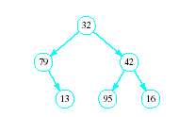
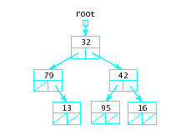
Linked Representation of Binary Trees
Example
Nyhoff, ADTs, Data Structures and Problem Solving with C++, Second Edition, © 2005 Pearson Education, Inc. All rights reserved. 0-13-140909-3

